Slide 1
French
All About Ourselves
Year One
French | Year 5 | All About Ourselves | Fashion | Lesson 4

Slide 2
La mode (Fashion)

Slide 3
Aim
I can write a range of sentences to describe other people.
Success Criteria
I can write sentences in the third person (he and she).
I can add detail to a description of someone’s clothes with a colour adjective.
I can make the adjective and noun ‘agree’.

Slide 4
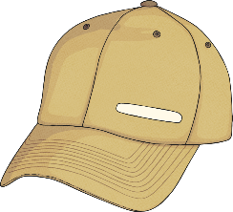
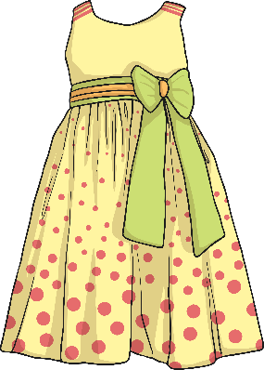
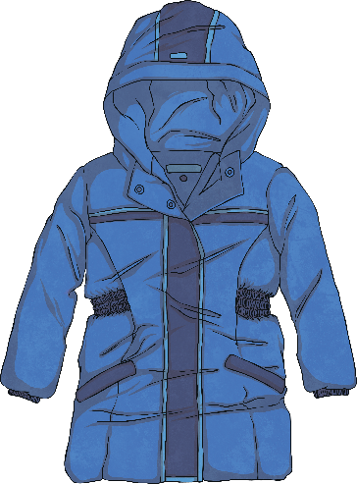
What Do You Remember?
Click play buttons throughout to hear phrases and words.
Can you remember the names of the clothes?
Voici un chapeau.
Qu’est-ce que c’est ?
C’est une robe.
C’est un manteau.

Slide 5
Posez la question (Ask the Question)
Je porte une chemise, un manteau, un pantalon et des chaussures.
Qu’est-ce que tu portes ?

Slide 6
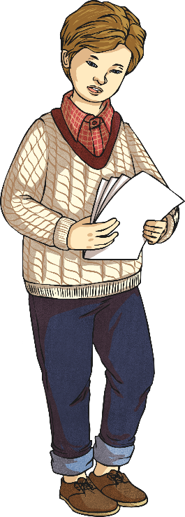
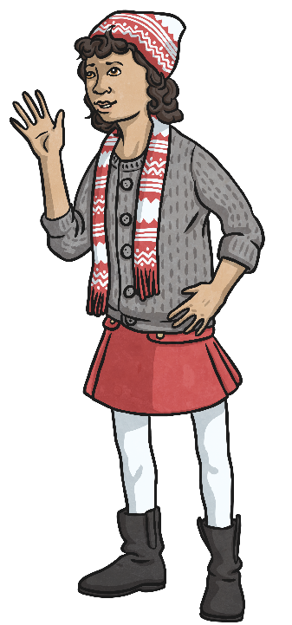
Posez la question (Ask the Question)
To ask about other people, we need to change the pronouns from ‘I’ and ‘you’, to ‘he’ and ‘she’.

Slide 7
Il porte… (He’s Wearing…)
Il porte un pull, une chemise, un pantalon et des chaussures.

Slide 8
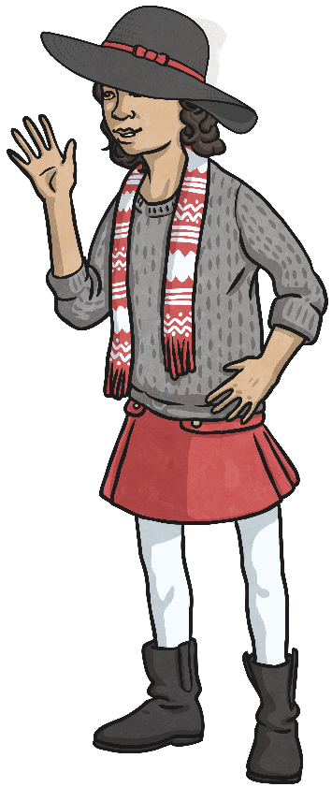
Elle porte… (She’s Wearing…)
Elle porte un chapeau, une écharpe, un pull, une jupe, des collants, et des bottes.

Slide 9
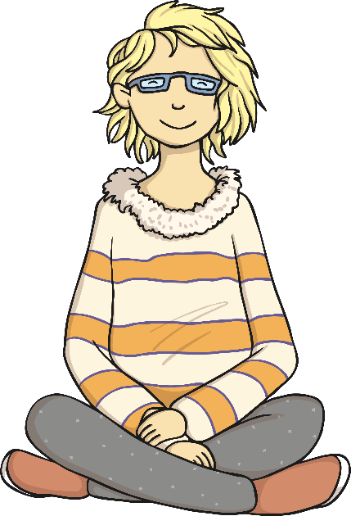
La grammaire (Grammar Point)
What could you say about this girl?
She’s wearing trousers.
Elle porte un pantalon.
To make the sentence more detailed, we can add an adjective.
Can you remember where the adjective goes in French?
She’s wearing grey trousers.
Elle porte un pantalon gris.

Slide 10
La grammaire (Grammar Point)
What else?
She’s wearing glasses.
Elle porte des lunettes.
What colour are they?
What’s different about the colour adjective?
Why do you think this is so?
She’s wearing grey glasses.
Elle porte des lunettes grises.

Slide 11
La grammaire (Grammar Point)
In French, nouns can be masculine or feminine, singular or plural.
Adjectives to describe them have to ‘agree’ with the noun.
un pantalon gris.
des lunettes grises.

Slide 12
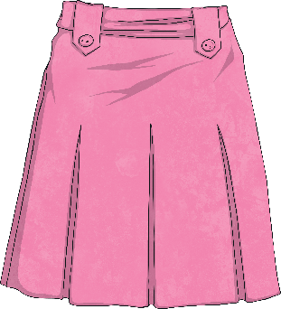
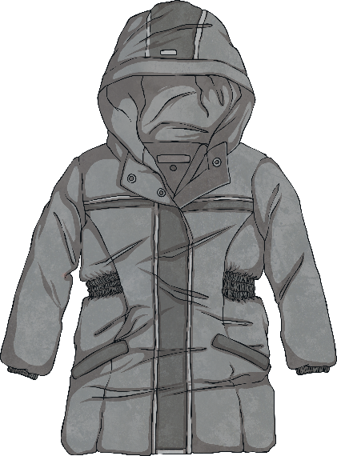
On va décrire les vêtements (Let’s Describe the Clothes)
un manteau gris
des gants verts.
une jupe rose

Slide 13
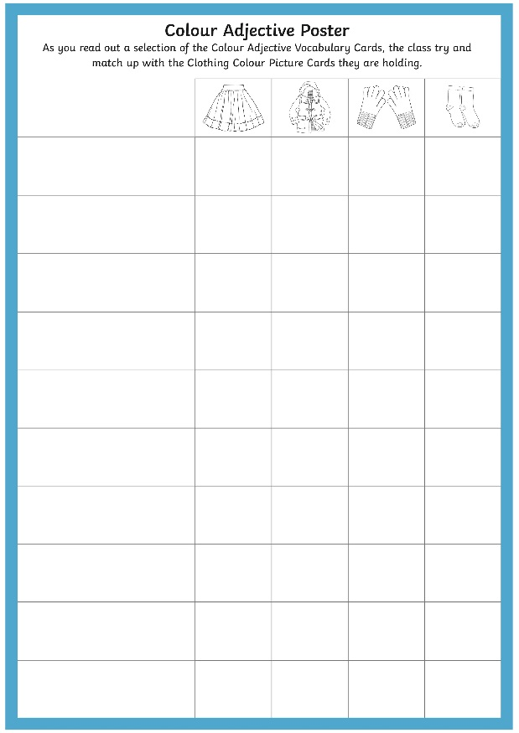
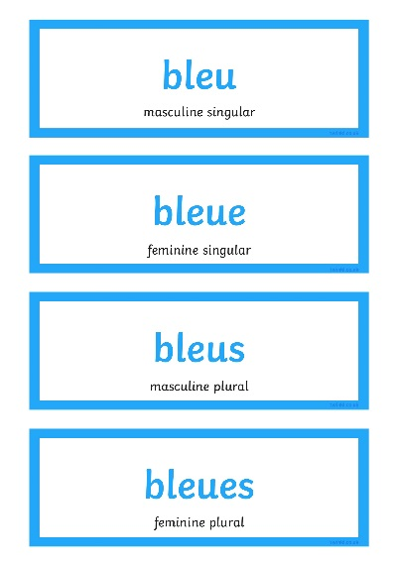
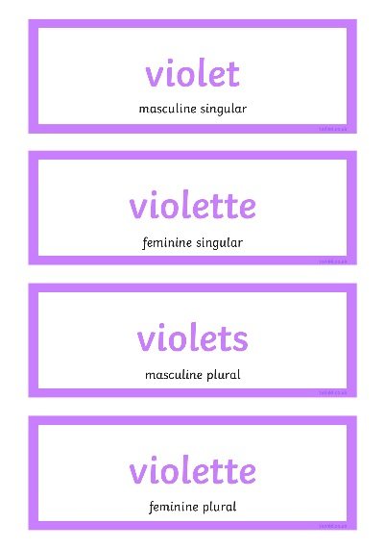
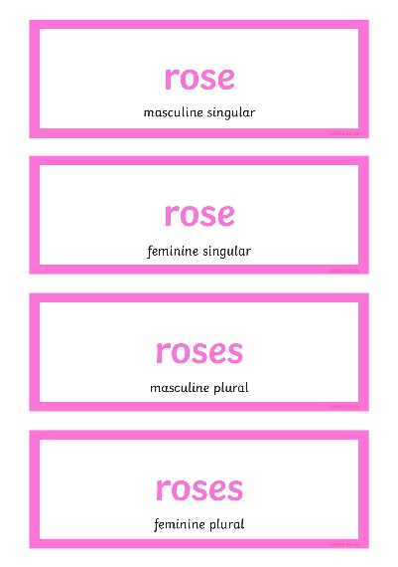
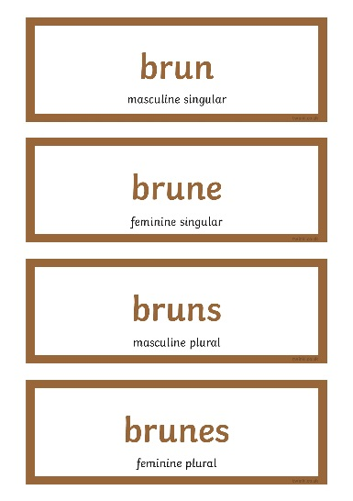
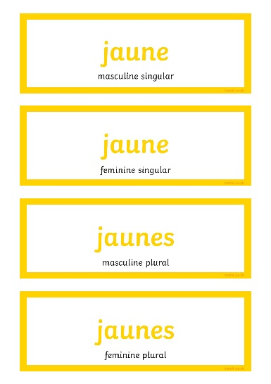
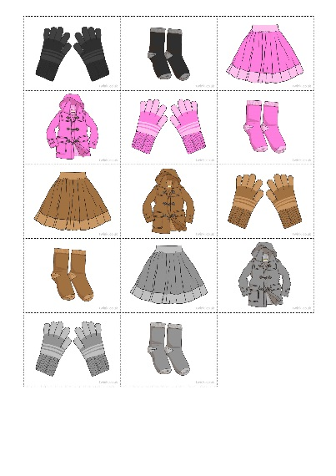
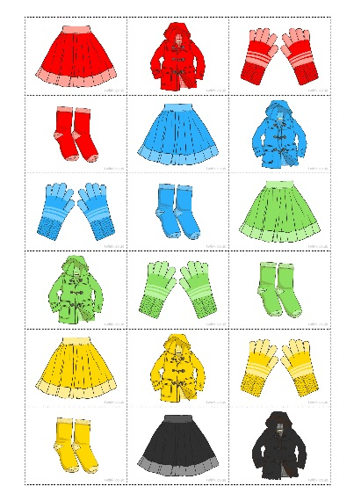
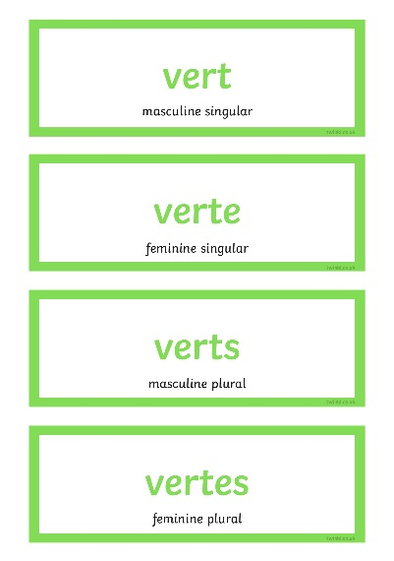
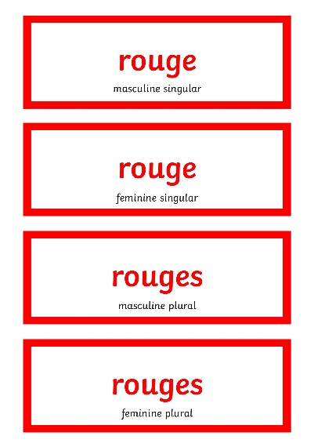
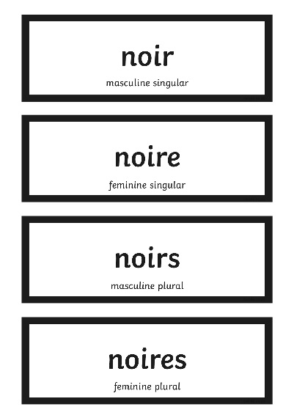
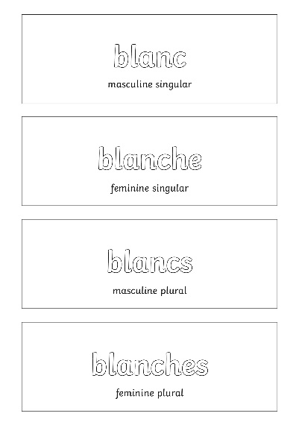
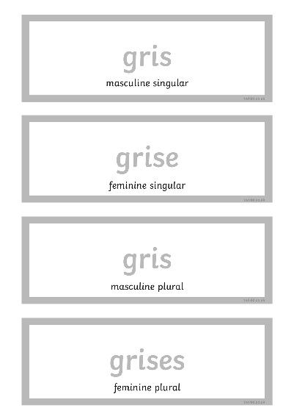
On va décrire les vêtements (Let’s Describe the Clothes)

Slide 14
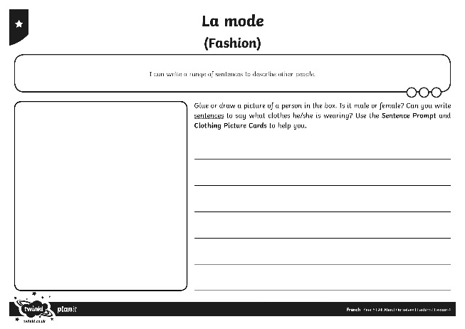
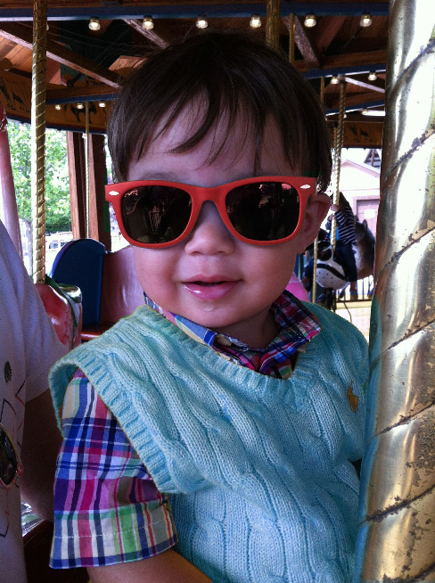
Dessinez-le (Draw It)
Elle porte un tee-shirt rose et un short bleu.
Il porte des lunettes rouges et un pull bleu.

Slide 15
Aim
I can write a range of sentences to describe other people.
Success Criteria
I can write sentences in the 3rd person (he and she).
I can add detail to a description of someone’s clothes with a colour adjective.
I can make the adjective and noun ‘agree’.

