Slide 1
Area of a parallelogram
Challenge slides

Slide 4
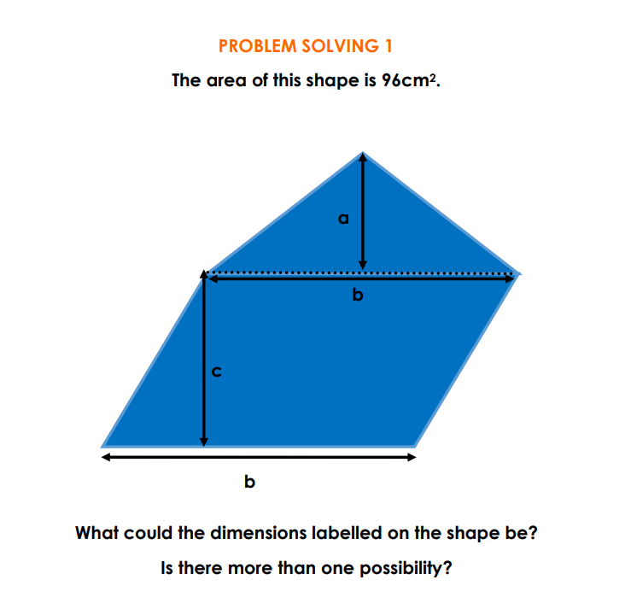

Slide 6
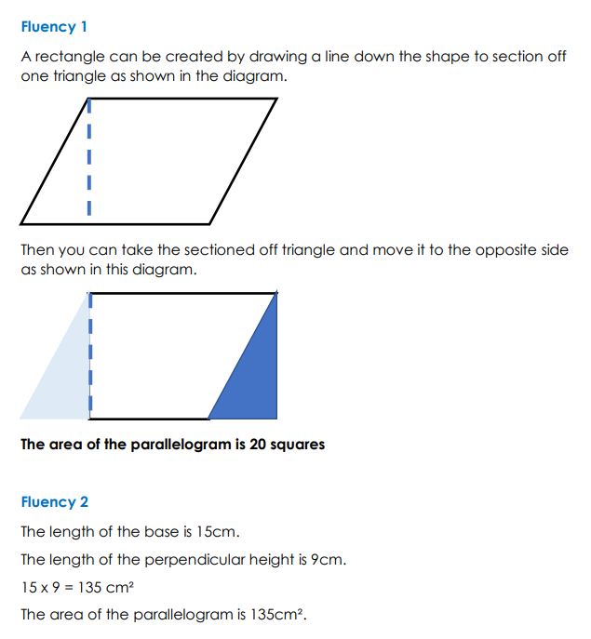
Answers

Slide 7
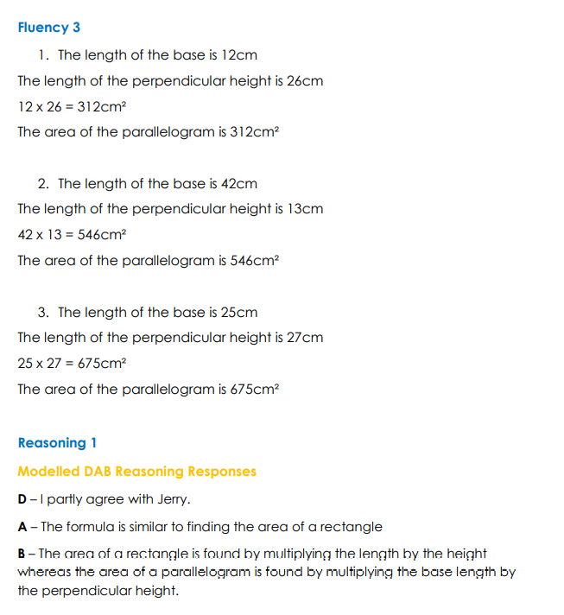
Answers

Slide 8
Answers

Slide 9
