Slide 1
Dragon
Hunter’s Guide to
Local
Dragons

Slide 2
Dragon Hunter’s Guide to Local Dragons
How to write an entry for the guide book

Slide 3
Today’s first task – optional task

Slide 4
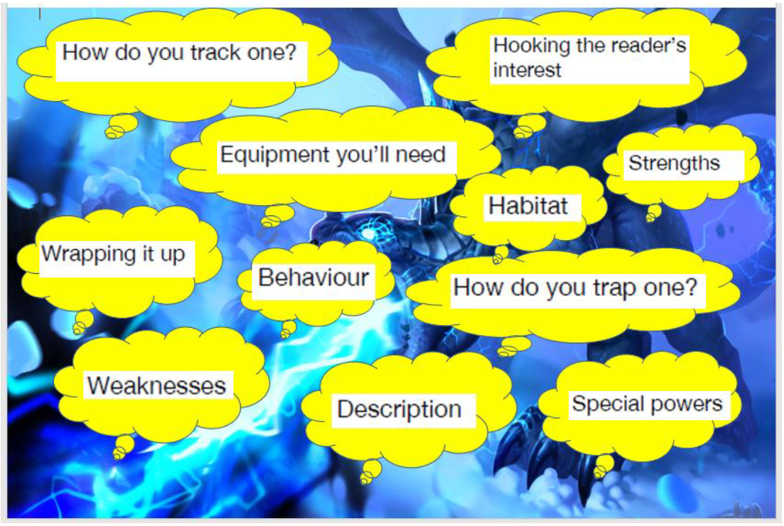
Today’s second task – optional task

Slide 5
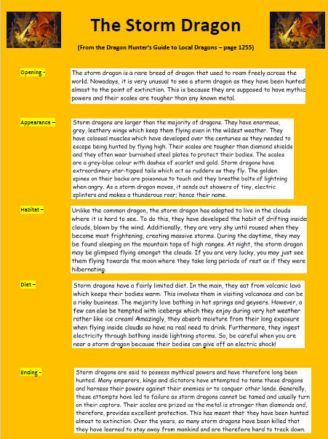
Today’s third task

Slide 7
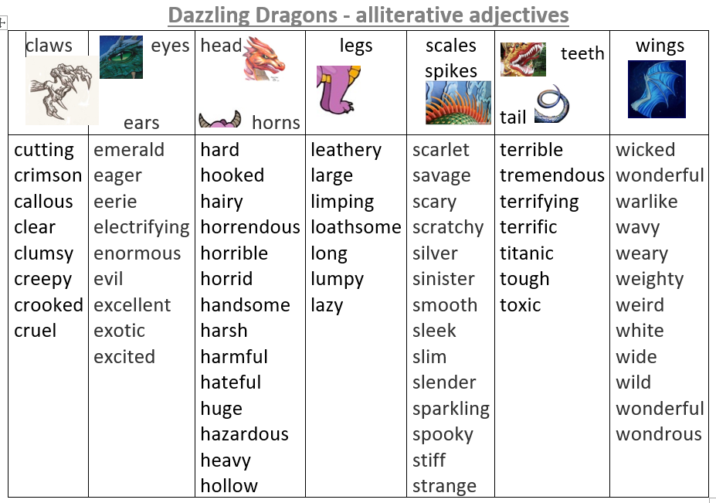

Slide 8
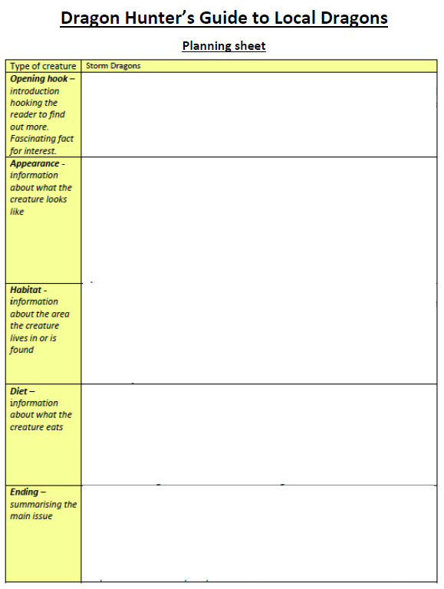
Today’s fourth task

Slide 9
So, today you are going to…
*Complete the first two optional tasks if you think you have time – you could always return to these at the end
* Read the WAGOLL – ‘The Storm Dragon’
* Collect useful words and phrases from your word mats and today’s WAGOLL
* Plan your Guide book entry using the planning sheet and the WAGOLL to help you
* Begin to write your entry for the Guide book

