Slide 1
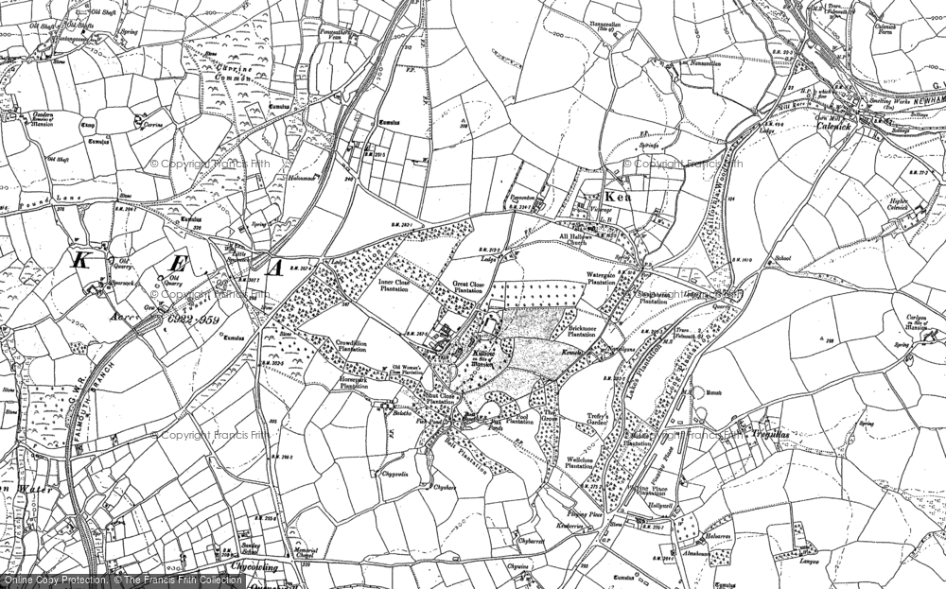
Beside The Seaside
Maths: Our units this half term are Addition and Subtraction, Place Value to 100, Fractions, Position and Direction and Time. More detail about the learning objectives we will cover this half term can be found here. | History: We will be learning about Seaside Holidays in the past. Brunel’s Tamar bridge and how this changed tourism in Cornwall. The Victorians and their typical day by the sea. What did they wear and do? Victorian beach activities compared with today. What has changed and why? Create a timeline of the seaside, including 1890’s, 1950’s and today. More detail about the learning objectives we will cover this half term can be found here. KIRFS- Key Instant Recall Facts and Skills- For children to learn in school and at home! A long time ago, people dressed differently to go to the beach. Vocabulary- parasol, promenade, Punch and Judy, bathing machine, donkeys, carriages, railway, Victorian, dress, gown, suit, steam train, deck chairs, now, then, modern, nowadays, past, present, pier, invention, clothing. | English: We will be learning , retelling and writing stories using “Talk for Writing” skills. We will innovate and recreate our own versions of, “Sally and the Limpet” and “Soggy the Bear”. We will read “At the Beach” Roland Harvey and write our own postcards following our Beach Trip.We will use 2A sentences and similes to write our own seaside poems using “Commotion in the Ocean” and Nick Sharratt’s “Seaside Poems” . We will continue to use full stops, capital letters, commas in a list , exclamation marks and question marks correctly. We will write complex sentences with more confidence and further build our bank of sentence starters. RWInc continues to be taught daily along with new handwriting joins
Science: We will be learning about Human bodies. Animal life cycles How humans grow and change Eating healthily The importance of exercise Hygiene Our Five Senses.
 |  | Art: We will be experimenting with wax resist, watercolour and salt to create patterned underwater pictures. We will continue learning about Van Gogh as an artist , looking closely at 'Fishing Boats on the Beach at Saintes- Maries-de-la-Mer’. We will create our own mixed media versions, noticing perspective and horizons.
Count to to 100
Identify halves and quarters
Tell the time to the hour and half hour

Slide 2
Beside the Seaside
P.E. We will practice for Sports Day and participate in the races and activities it offers. We will try circuit exercises to improve fitness. We will learn to use a bat and ball in various games. | DT We will be designing, making and evaluating our clay tiles .We will be rolling, cutting, painting and decorating clay tiles to create a seaside tile souvenir from our beach trip. | PSHE: We will learn about our feelings and how to recognise feelings in others. We will learn about changes in our lives and how to cope by calming down or talking to others. We will name external body parts and learn the “Pants” rule. We will learn about what is ok and not ok in relation to our bodies. We will review our progress in Year 1 and set new targets. More details can be found here.
 | Music: Seaside songs We will be finding the pulse, copying, clapping and making up our own rhythm. Playing instruments, using the notes c and g Improvising using the notes C+D We will learn a medley of seaside songs and accompany them with percussion instruments More detail about the learning objectives we will cover this half term can be found here. .
We will visit a local beach and carry out a beach clean and some rock pool investigations.
We will perform a seaside song, present a seaside gallery and a fun seaside quiz for the adults.
We will learn about how holidays in Cornwall have become more popular.

