Slide 1
Volume by counting cubes - maths challenge

Slide 2
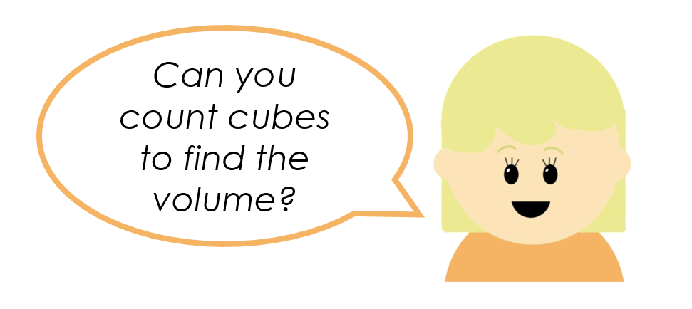

Slide 13
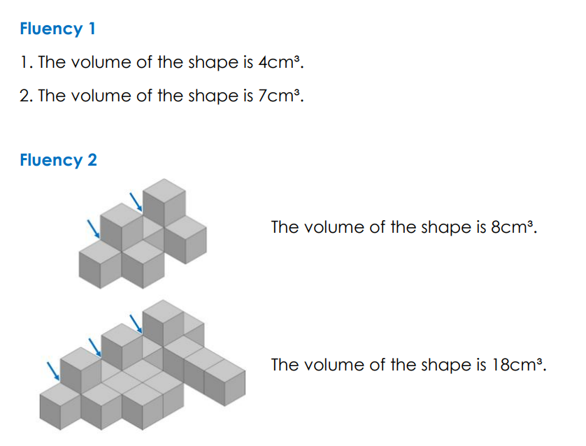
A
N
S
W
E
R
S

Slide 17
