Slide 1
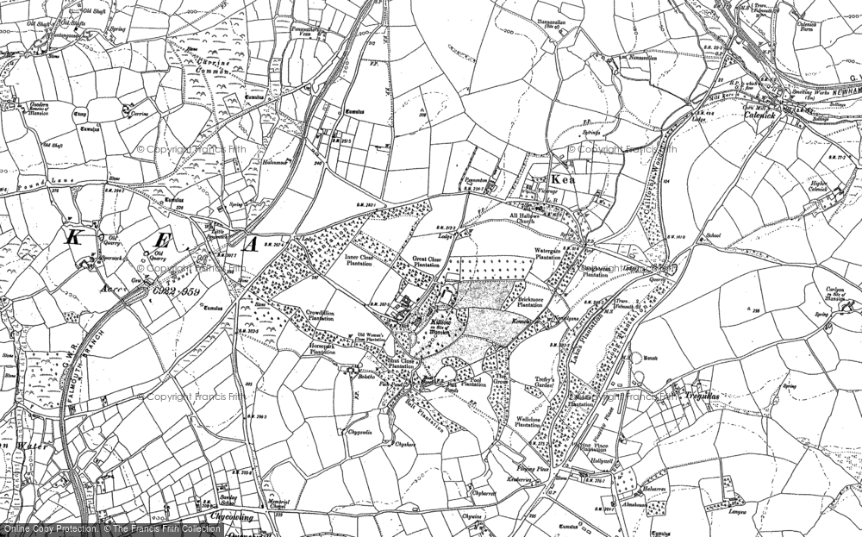
Food
We will create a Food Magazine with traditional and healthy recipes, scientific facts as well as food related stories and artwork
MATHS: We will be naming, sorting and recognising 2D and 3D shapes, mastering the place value of numbers 0-20, including the value of tens and ones parts of numbers. We will add and subtract numbers between 0-20 and master the place value of numbers 0-50. Please see our Maths Parent Overview for more information and support. | GEOGRAPHY: We will be locating and learning about the 4 countries of the UK, locating these countries and their capital cities on the map and finding out about foods traditionally grown and cooked there. | ENGLISH: In Literacy we will be reading and writing our own versions of "The Tiger Who Came To Tea“ and "The Lighthouse Keeper's Lunch". We will learn each story through our story maps and write the stories , improvising with some of our own ideas. We will learn how to write recipes using “bossy verbs” through "Talk for Writing". We will be improving our sentence punctuation and extending our sentences using ‘and’, ‘but’ or ‘so’.
SCIENCE: In Science we will learn about our bodies and how they have changed since we were babies. We will investigate how to eat healthily, explore our five senses and discover how some people manage without one or more of their senses. | ART: In art we will make our own dinner place mats, using food printing techniques. We will look carefully and draw different fruits and vegetables. Finally, we will produce our own Archimboldo collages. | PE: Our focus this term will be:sending and receiving a ball, bouncing and catching, racket handling skills, throwing and aiming a ball at a net, kicking and, striking a ball with a bat or racket, throwing, catching, controlling and movement skills.
PSHE: Our unit this term is ,”Diverse Britain”. We will learn about rules in our school community, how my behaviour in school affects others, how I can help and care for others in my community and what it is like to live in the British Isle. | MUSIC: We will learn about beat, rhythm and percussion instruments.We will listen to How Blue Can You Get - B.B. King, Livin’ La Vida Loca - Ricky Martin and Jai Ho - J.R. Rahman , creating our own percussion improvisations | RE: This term we will continue our learning about the beliefs of Jewish people. We will learn about Shabbat and Sukkot and how both events are practiced and celebrated. We will relate this to the stories behind these events and how we celebrate in our own lives
The UK is made up for 4 countries
The 4 countries of the UK are :England, Scotland, Wales, Northern Ireland
The capital of England is London
The capital of Scotland is Edinburgh
The capital of Wales is Cardiff
The capital of Northern Ireland is Belfast
Some of our class books for this term will be, ‘The Tiger Who Came To Tea”, “The Lighthouse Keeper’s Lunch” (and other books in this series), “Oliver’s vegetables, “Eddie's Kitchen : And How to Make Good Things to Eat”, “Ultimate Step-by-step Kid's First Cookbook”.
We will visit Truro to research information we need for our large scale art map.
Our class books for this term will be ‘The Storm Whale’ and ‘The Storm Whale in Winter’

