Slide 1
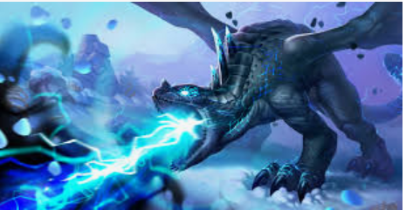
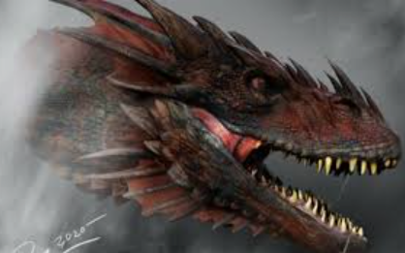
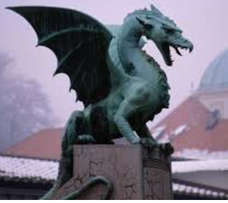
Writing a dragon poem
Tuesday 2nd February 2021

Slide 2
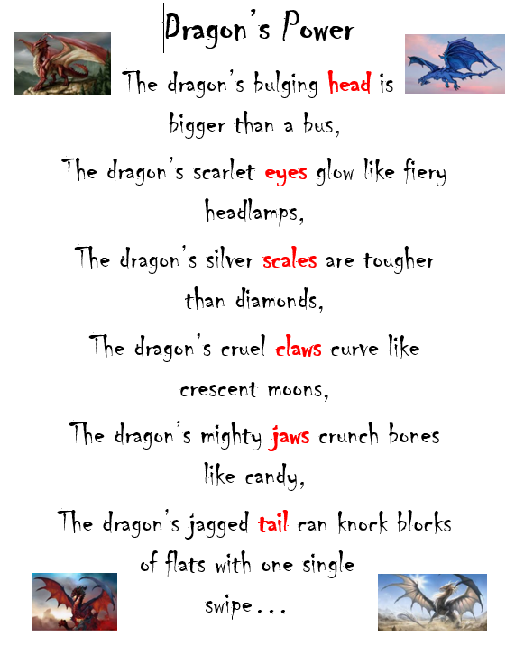
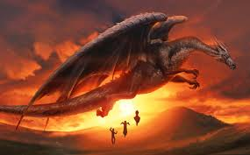
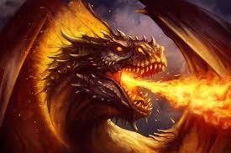

Slide 5
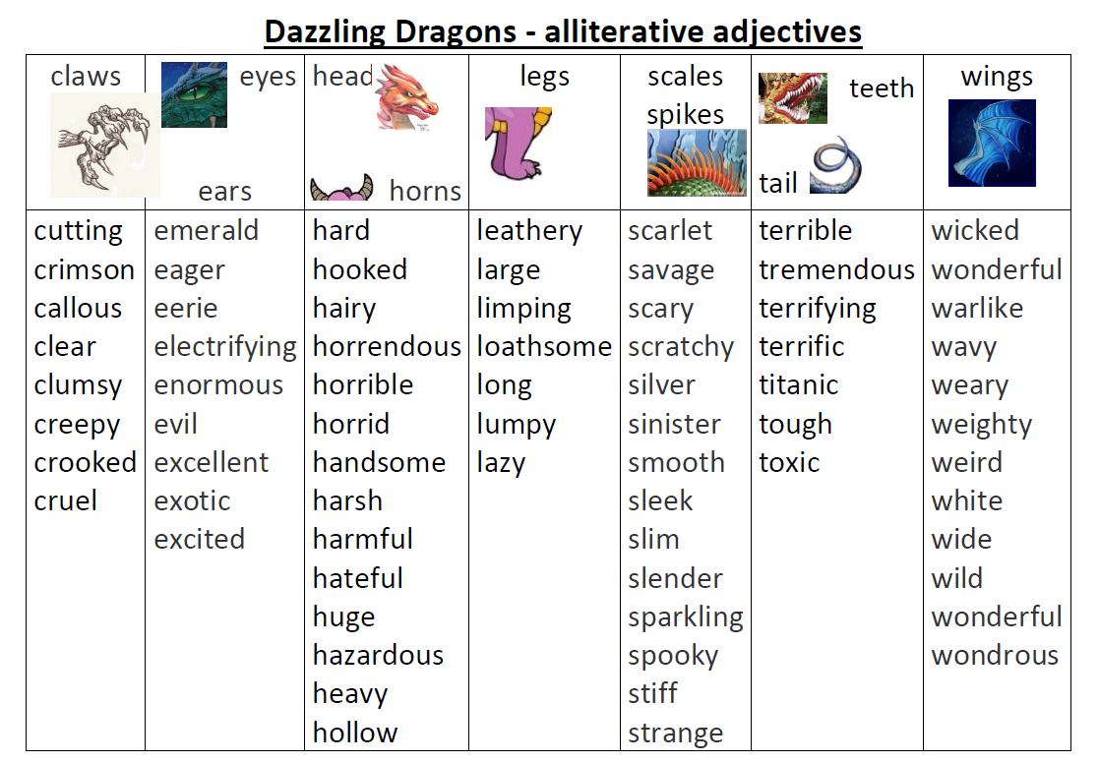

Slide 6
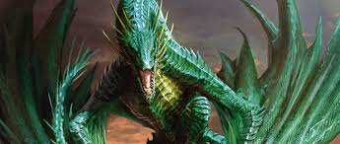

Slide 7
The dragon’s hideous head is larger
than the largest mountain

Slide 8
The dragon’s hideous head is larger
than the largest mountain
(using a comparative)

Slide 9
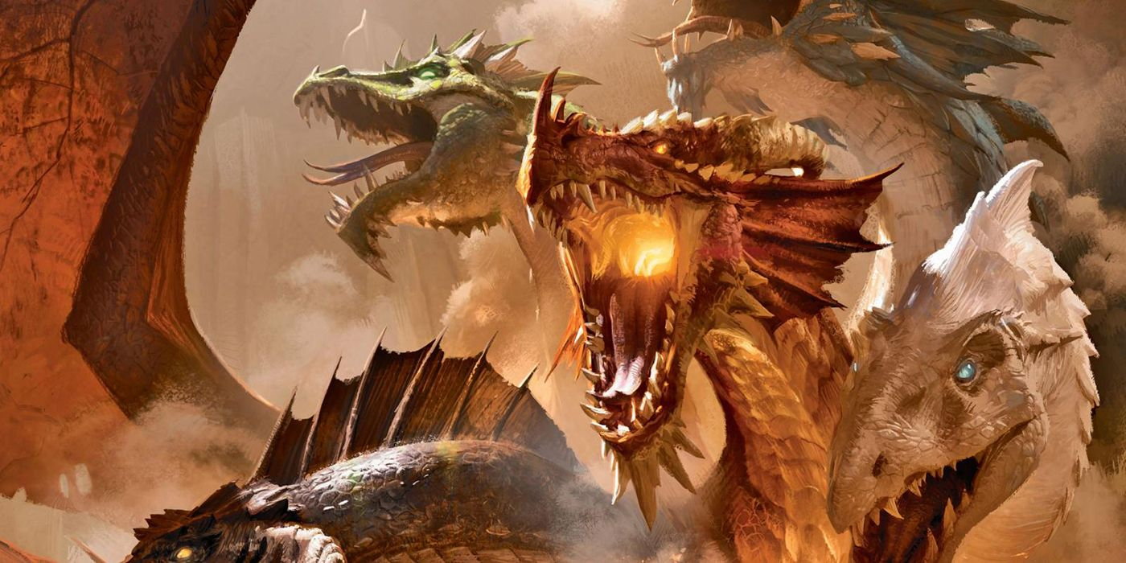

Slide 10
The dragon’s emerald eyes are terrifying pools of lightning,

Slide 11
The dragon’s emerald eyes are terrifying pools of lightning,
(using a metaphor)

Slide 12
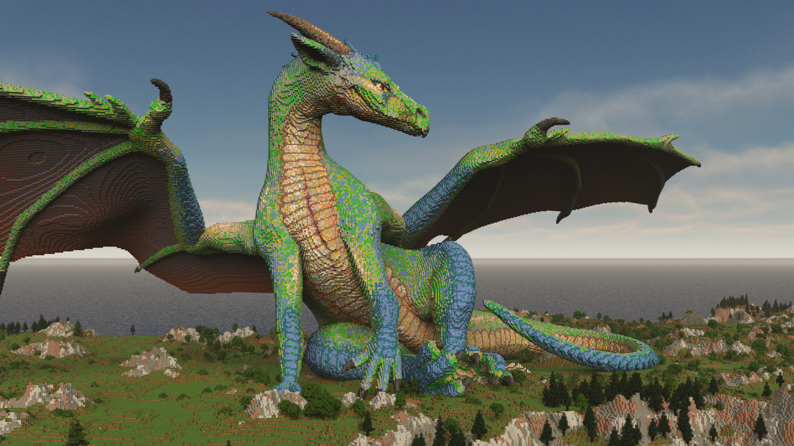

Slide 13
The dragon’s silver scales are as sharp
as razor-sharp sabres

Slide 14
The dragon’s silver scales are as sharp
as razor-sharp sabres
(using a simile)

Slide 15
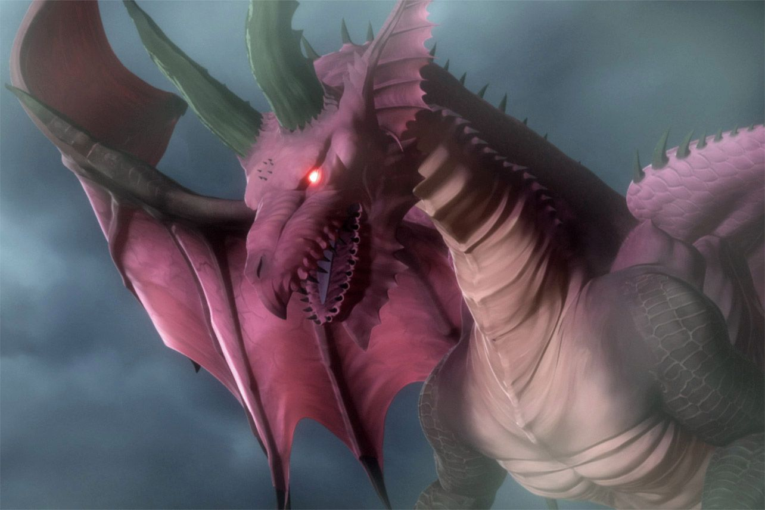
Now, it’s your turn…
*rewrite each line of the Dragon’s Power poem
*keep the word in red the same
*magpie the best vocabulary
*use comparatives, similes and metaphors
*be amazing!!!

