Slide 1


Reading advice for parents

Slide 2

The benefits of reading with your child:
Whether you’re reading a classic novel or fairy tales before bed, reading aloud to children and hearing them read can significantly benefit your child’s life. Reading with your child benefits:
Cognitive development
Language skills
Preparation for academic success
A special bond with your child
Concentration and discipline
Imagination and creativity
A lifelong love of reading

Slide 3

Making a start
Choosing “The right book” .
Following recent OFSTED advice, your child should be able to read their book fluently, which means they should only be sounding out 1 in 20 words. If they are stopping to sound out every other word , the book does not match their ability yet and they need to choose a more comfortable read.
Find a quiet , comfortable place for you both to sit side by side.
Show genuine interest and enthusiasm in the book they have chosen.
Allow the child to hold the book themselves.

Slide 4

Don’t open the book yet! Explore the front cover:
What / Who can you see on the front cover?
What do you think the book might be about?
What makes you think this?
Ask them to find the title and read it. Does this give another clue?
Who is the author?
Is it a story book or information book? How do you know?

Slide 5
Open the book:
Discuss the picture first, before starting to read the words:
Who can you see ? What are they doing ?
What/ who else can you see?
What are they doing? How might they be feeling?
I wonder what will happen?

Slide 6
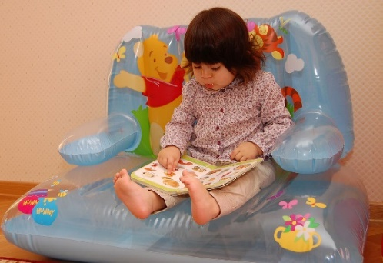
Reading the text:
Your child needs to point to the words themselves. Make sure they do this themselves, don’t be tempted to do this for them.
Some of the words are phonetically decodable (green words) and some are not (red words)
For words they can sound out, they use their “Fred Talk” with no “uh” sounds at the end eg SSSSSSSSSSSSSSS , not suh. Parent video: How to say the sounds - YouTube
Allow time for them to decode the word before you “jump in”, they will often get there themselves.
Context and picture clues also help them to make sense of the text

Slide 7
Comprehension and Reasoning questions
These questions are also in the front of their reading record book to help develop a greater understanding and enjoyment of their books.
Allow the reading to flow for a few pages and then ask 1 or 2 of these questions:
What has happened in the story so far?
What are the characters like?
Where is the story set? How do you know?
What happened when….?
How would you feel if you were this character?
What do you think will happen now? How do you know?
What does the character mean when they say…….?
What happened when….?
Find your answer in the text to “Prove it”.
Did you enjoy the story? Give your reasons why/why not?
Talk about any links between the story and the child’s own experiences.

Slide 8
Always be positive!
Make the experience a positive one for both you and your child.
If you have any concerns or questions , don’t hesitate to speak to the class teacher at a convenient time.
Thank you, your support is so valuable!

