Slide 1
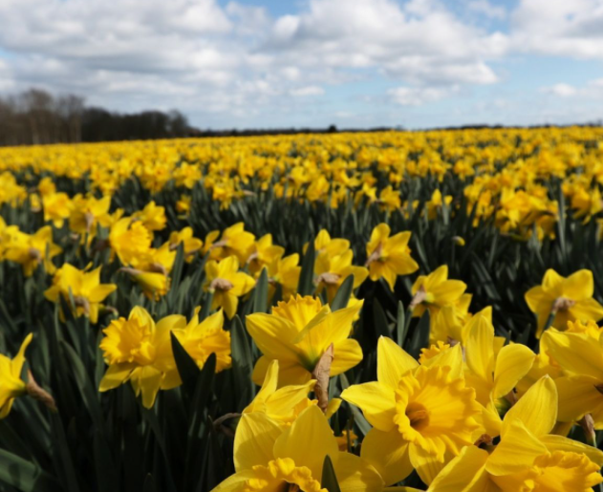
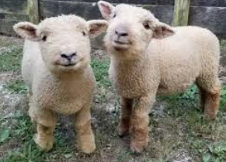
Hope Springs art competition
You can use anything you like to produce it including pencils, paints, felt tips…anything! On A4/A3 paper please
Create a drawing/ painting about what ‘hope’ means to you.
Closing date
Wednesday 3rd March
Send into school via Teams

