Slide 1
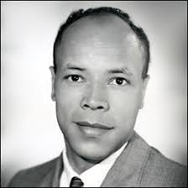
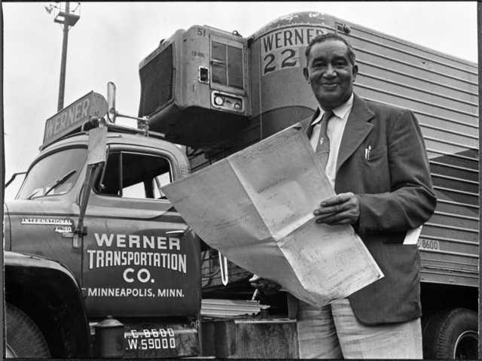
More Famous Transport Inventors

Slide 2
Do you remember these names from last week’s lesson on cars?
Benz (motor wagon)
Baker (electric cars)
Ford

Slide 3
Today we are going to learn about two more inventors who improved road transport…
and
Meredith Gourdine
Frederick McKinley Jones

Slide 4
I wonder what this man invented?
A clue-
Meredith Gourdine invented something to
Help stop air pollution from cars…

Slide 5
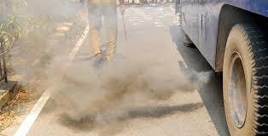
….He Invented the catalytic converter.
He loved working with engines but realized that the fumes from the motors was very dirty and making the air dangerous and dirty.
In those days the fumes from cards were so dirty that the air sometimes appeared foggy in very busy towns where there were more cars.

Slide 6
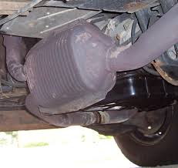
He worked very hard and invented a piece of equipment to clean up the fumes before they were pushed out of the exhaust. The fumes were not completely clean , but they were cleaner than without the ‘catalytic converter’.

Slide 7
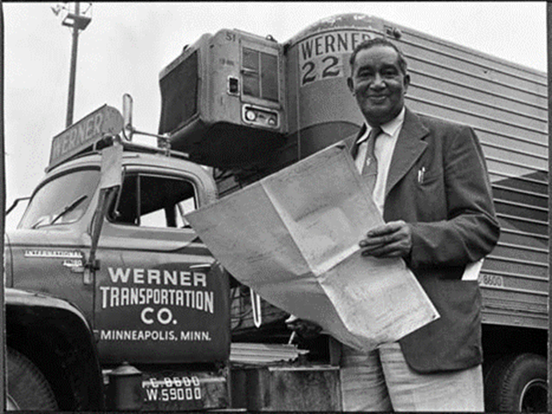
What do you think this man invented?
Clue-
Without this invention the ice cream would melt!
Without this invention we would get very hot in our cars in the summer.
Frederick McKinley Jones

Slide 8
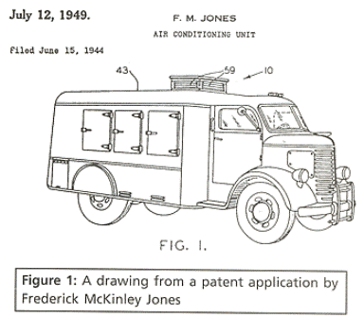
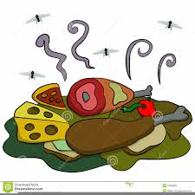
Frederick Mckinnley Jones developed refrigeration for lorries and vans to keep food cold.
Before his invention, food that was transported a long way would have gone off very quickly and would have been very smelly.

Slide 9
Imagine what an ice cream van would look like without refrigeration?

Slide 10
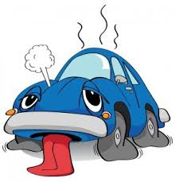
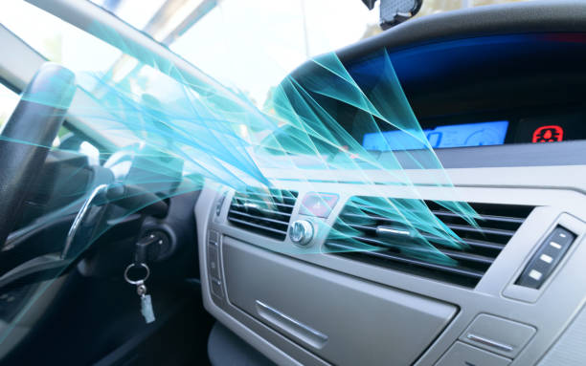
Frederick also used his invention to develop air conditioning in cars.
Thank you Frederick!

Slide 11
Your task this week is to ask someone in your household if they have ever heard of either:
or
If they have not, tell them about one of these inventors!

Slide 12
Great work children!

