Slide 1
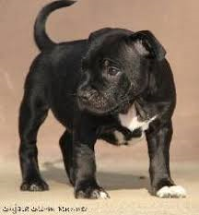
Lock down
By Issey
So cute .

Slide 2
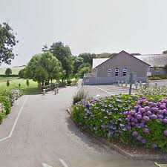
SCHOOL
Lock down Isn't very nice because you can’t see your friends and go to public places.

Slide 3
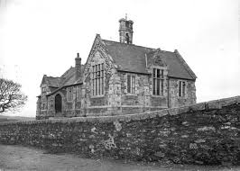
When Lockdown is over
When lockdown is over we can go to each others houses and play . I miss my friends very much and I know that you do too . I can’t wait too see my friends .

Slide 4
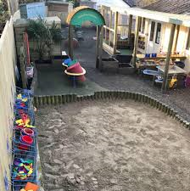
Lockdown is weird
Also preschool isn’t open but it might open sometime this week or next week .
Lockdown is weird because we are not in are classes and some of us are at school .

Slide 5
Do you like lockdown? because I do
I like lockdown because I get to walk my dog every week .
I miss you all very much
This is like my staffy my staffy is called Honey .
Bye everyone

