Slide 1
Area of triangles part 2 - maths challenge
Friday 26th February 2021

Slide 10
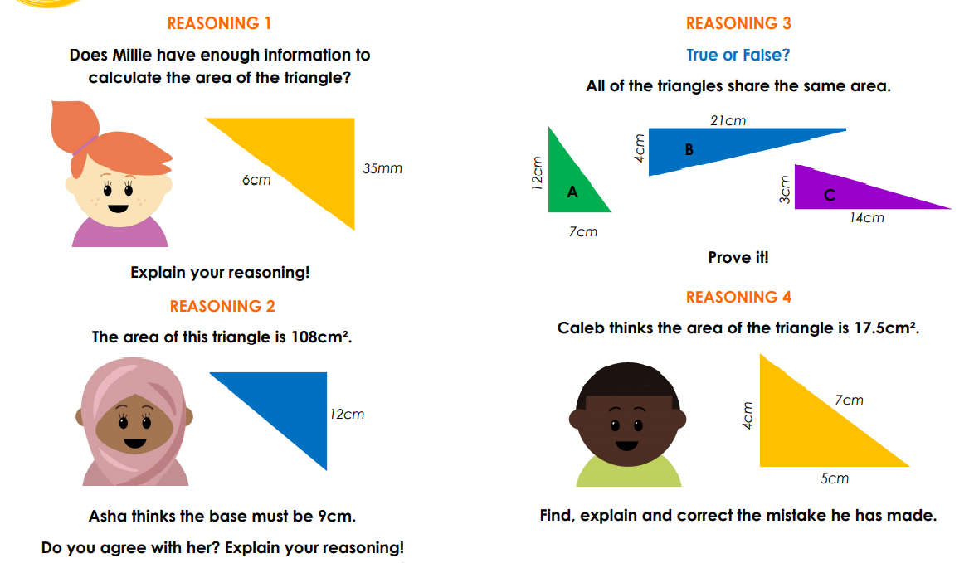

Slide 12
A
N
S
W
E
R
S

Slide 13
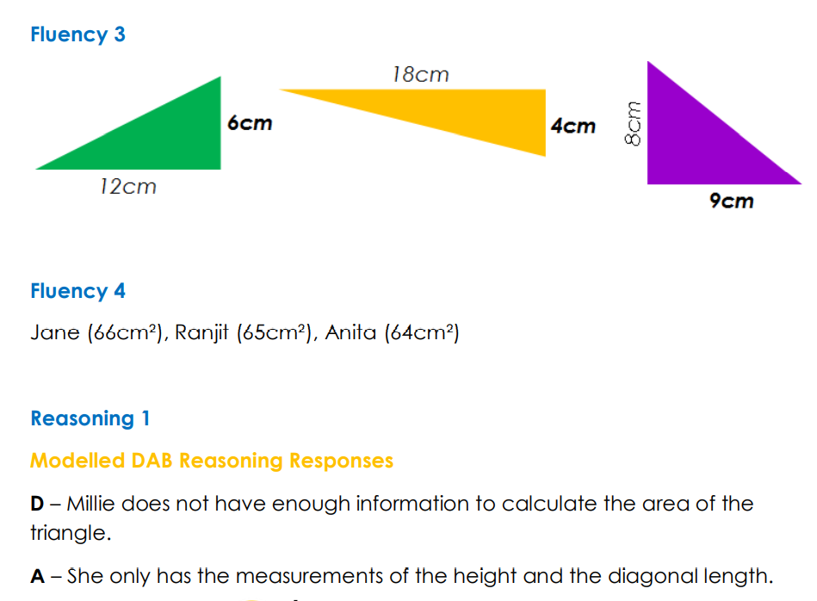

Slide 14
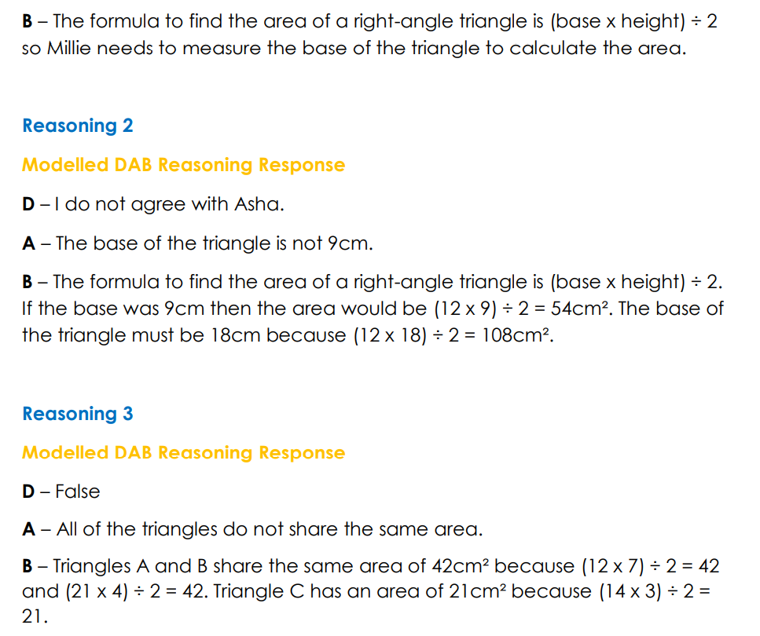

Slide 15
