Slide 1
There are many different types of bridges around the World…

Slide 2
Can you think of any bridges you have crossed?
Have you used the Tamar Bridge?

Slide 3
Bridges are built for different reasons
Some are for cars
Some are for people
Some are for trains
Look at the bridges on the first slide, do you think they were built for cars, people or trains?

Slide 4
Build a bridge challenge
Can you build a bridge for a toy car to drive over or a Lego Minifigure to walk over?
Think about:
What materials you will use – you could use newspaper, card, lego, duplo, sofa cushions, kitchen utensils – it’s up to you!
How big (or small) your bridge will be
How you will make it strong enough

Slide 5
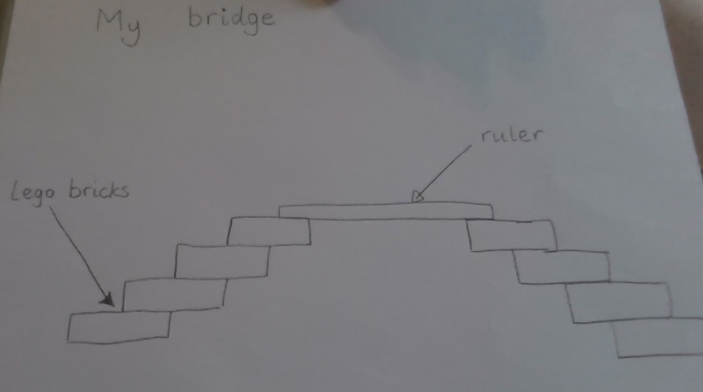
STEP 1
Draw a picture of your bridge – this is called ‘Designing’
You might be able to add labels to your picture to show what you are going to use to build it

Slide 6
STEP 2
Have some fun and enjoy making your own bridge!

Slide 7
STEP 3
Can you EVALUATE your bridge?
What do you like about it?
Does it stay up?
Can you improve it?

